Slide 1
The Recipease Project
CS 3410 (Fall 2011)
by Quinn Heiner, Stephen Shaw, & Nathan Liddle

Slide 2
Project Presentation Outline
Project Introduction – Nathan
* About the Recipease project
* User demographic
* Conceptual database design/initial ER diagram (next 2 slides)
Project Development - Stephen
* Technology Considerations/Approaches
* Decision to change from Django to .NET
* Overall process – what went well/not so well, what we learned, etc.
Live Project Demo - Quinn
4 modules:
* Recipe
* Pantry
* Meals
* Shopping List
URI (Campus network only): http://161.28.118.37/Recipease/

Slide 3
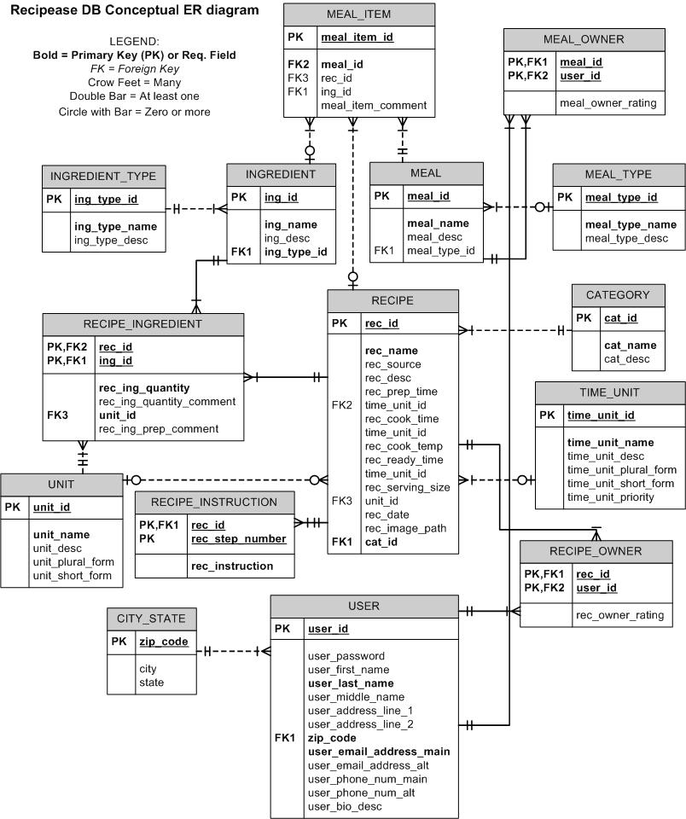
Recipease DB Conceptual Model

Slide 4
Recipease DB Conceptual Model, cont.

Slide 5
Questions?

